Slide 1
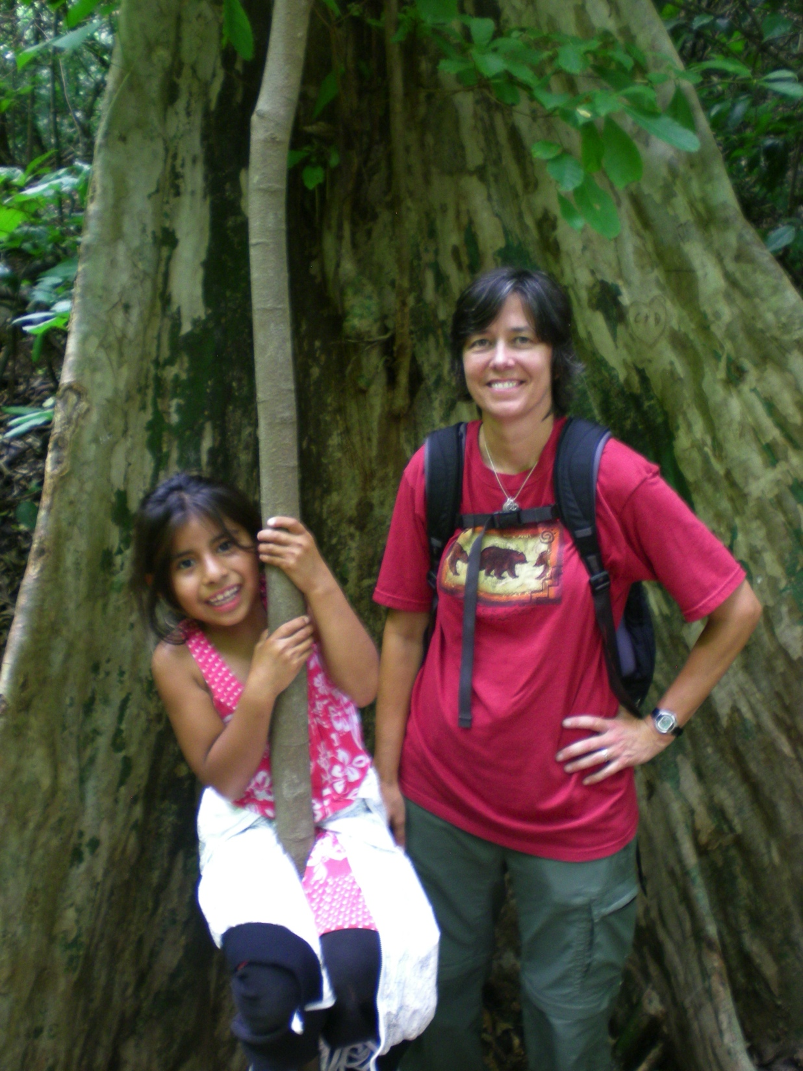
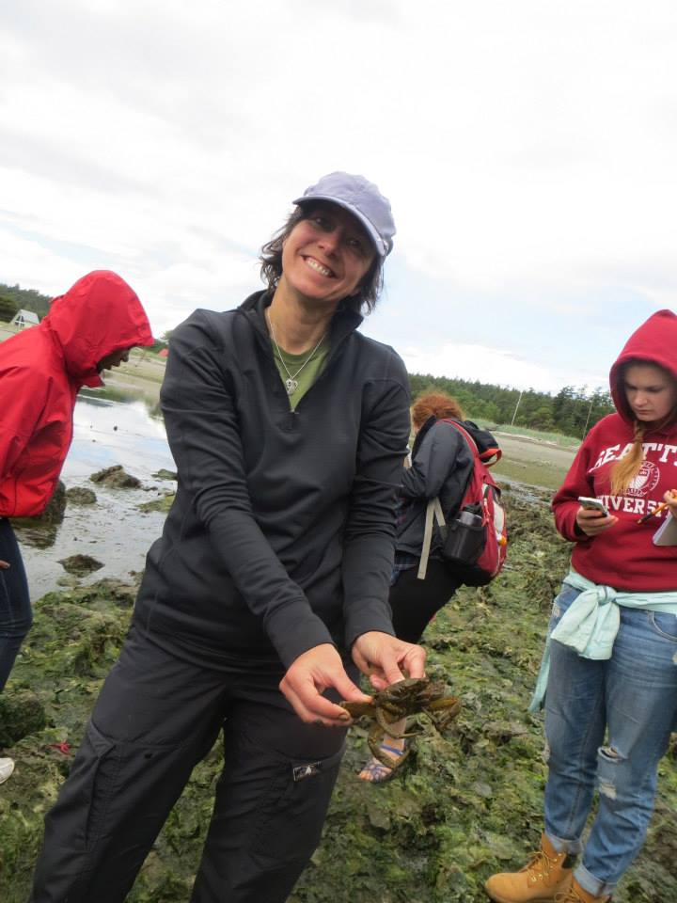
Brenda Bourns
Office Hours: Please ask!

Slide 3
UCOR 3800 Global Challenges

Slide 4
UCOR 3600/3800: Natural/Social Science and Global Challenges Core Learning Objectives
Gain additional scientific knowledge and improve your ability to use rigorous scientific thinking to answer questions and solve problems.
Develop your ability to reflect on and use relevant knowledge you have learned in other courses across a variety of disciplines.
Become an effective writer, including writers of high quality academic prose.
Learn to engage in persuasive communication in appropriate civic spheres.
Deeply understand a major global issue or challenge (primarily through the perspective of a natural/social sciences discipline).
Understand relevant cultural dimensions of the global challenges being studied and, when appropriate, develop awareness and skills in cross-cultural engagement.
Notes:
This course should help you….

Slide 5
UCOR 3800 Global Challenges
Social Sciences
Natural Sciences

Slide 6
UCOR 3600/3800 Environmental and Social Problems and Solutions in Nicaragua
Environmental science is interdisciplinary by its nature

Slide 7
Essential Background

Slide 8
Notes:
Are all conclusions given equal weight or do some emerge with more confidence?
What makes something “strong” scientifically? (Write on board)
Write on board
Rigorously tested
More statistically significant
Well Controlled
Objectively measured output
Blinded
Peer reviewed/Published
Repeated
Triangulated from multiple directions

Slide 9
Social Versus Natural Sciences
Natural science focuses on nature whereas social science studies human society (social, political, economic…).
Both use the scientific method
Both rely on observations of the world around us
Social sciences can also use qualitative methods (interview, participant observation, focus group, case studies) to generate conclusions
Notes:
We will be working with studies of both types

Slide 10
Primary literature describes studies and is written by the people who conducted the study.
Quantitative studies use numerical comparisons to describe observations and state the degree of confidence the study reports – this is often referred to as “statistical significance” to communicate that a study is significantly convincing to the discipline by the means outlined for that discipline.

Slide 11
Basic Environmental Science Background

Slide 12
Disturbance of Communities of Species
Disturbances
Are episodes that damage biological communities, at least temporarily.
Destroy organisms and alter the availability of resources.
Affect all communities.
Notes:
I discuss this topic by speculating on what would happen to your yard if you stopped mowing it. What would it look like in 5 or 50 years? What types of species would replace others, and why?

Slide 13
Ecological succession
Change in the species composition of a community over time
In primary succession
A community arises in a virtually lifeless area with no soil.

Slide 14
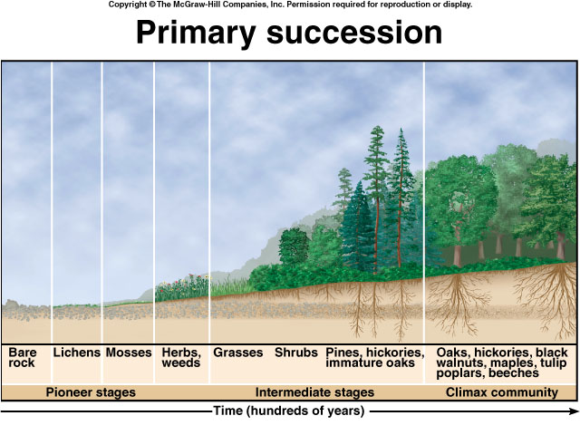
Notes:
Caused by volcanoes, road cuts & glaciers.
Pioneer species are lichens & mosses.
How long will it take to reach a climax for primary succession?
Takes hundreds of years for a climax community to develop.
What is Pac NW pioneer spp? Climax community?

Slide 15
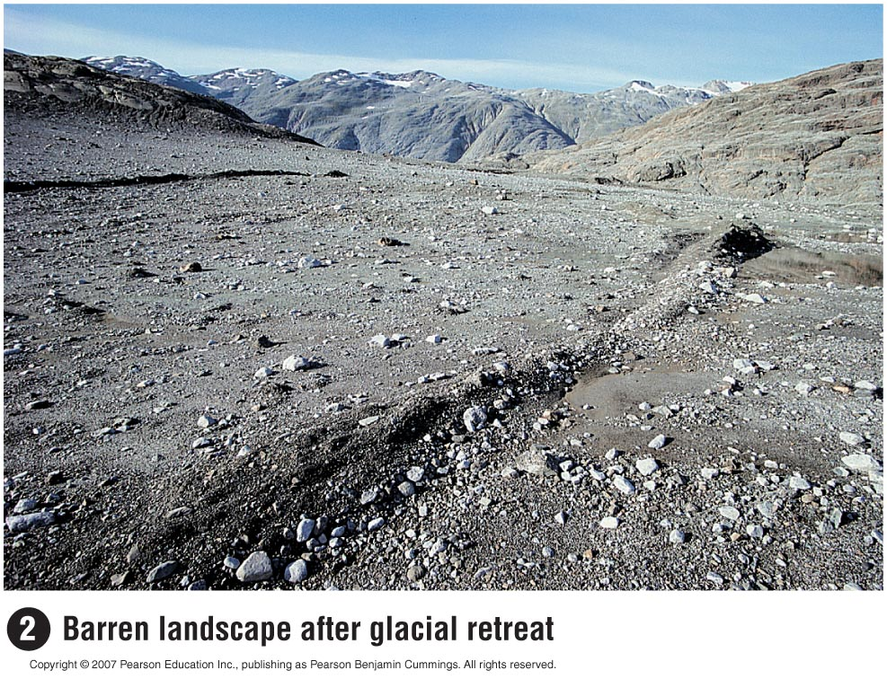
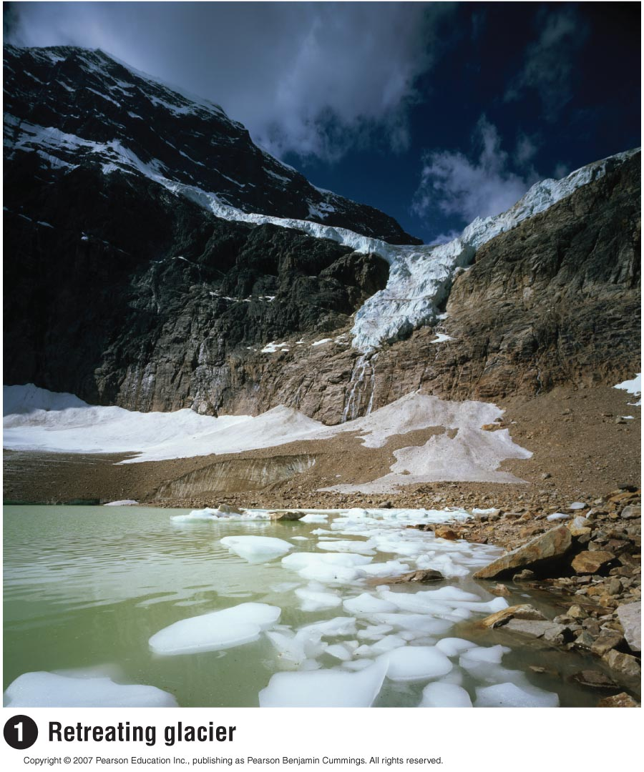
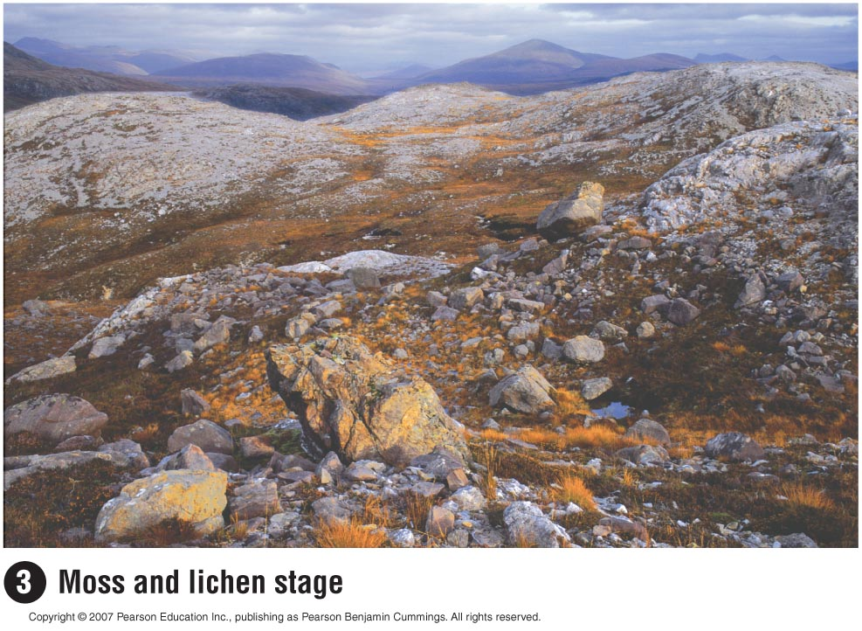

Slide 16
Secondary succession
Occurs in an area where a community is disturbed but not decimated (some soil & life remain).
Notes:
Caused by fires, hurricanes & agriculture.
Pioneer species are herbs & weeds.
Occurs faster than primary succession.
Still over a hundred years in most cases.

Slide 17
Notes:
Caused by volcanoes, road cuts & glaciers.
Pioneer species are lichens & mosses.
How long will it take to reach a climax for primary succession?
Takes hundreds of years for a climax community to develop.
What is Pac NW pioneer spp? Climax community?

Slide 18
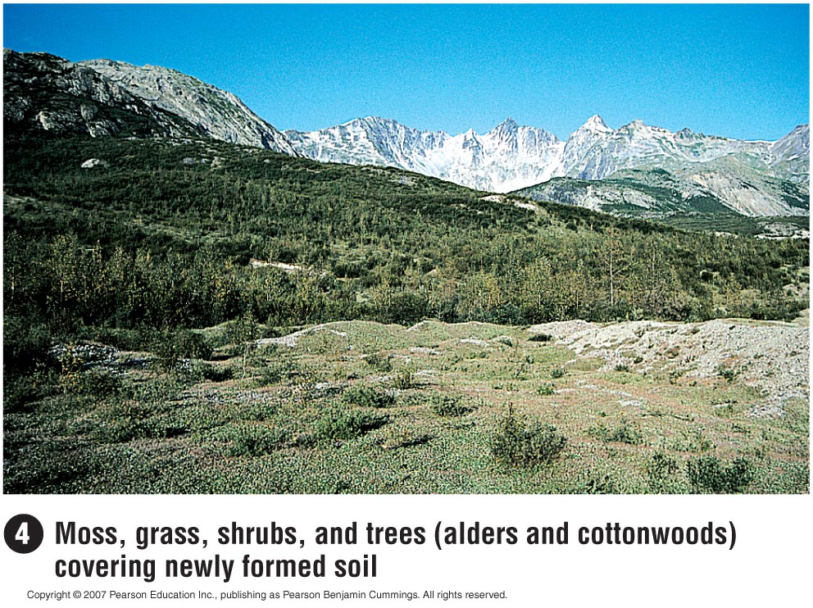
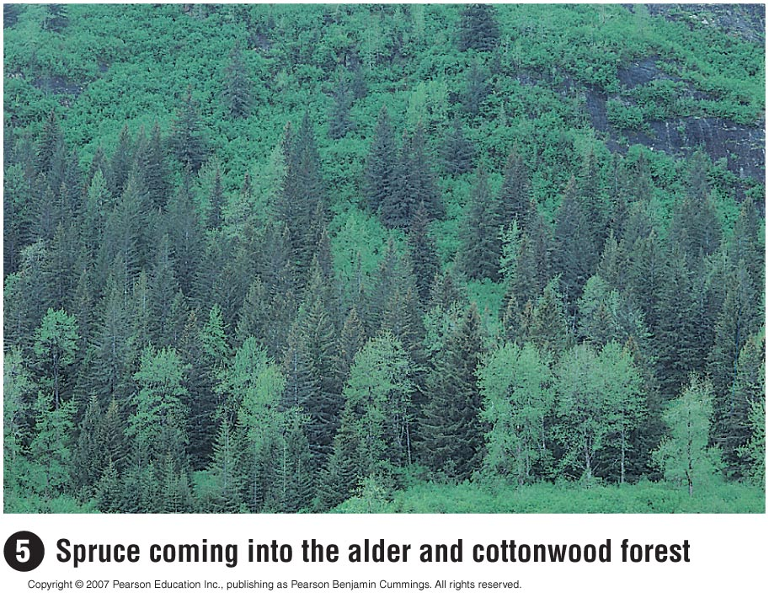
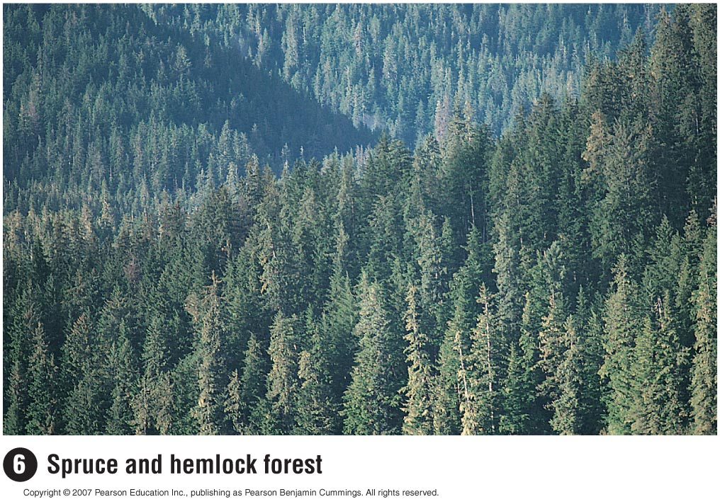

Slide 19
Notes:
Caused by volcanoes, road cuts & glaciers.
Pioneer species are lichens & mosses.
How long will it take to reach a climax for primary succession?
Takes hundreds of years for a climax community to develop.
What is Pac NW pioneer spp? Climax community?

Slide 20
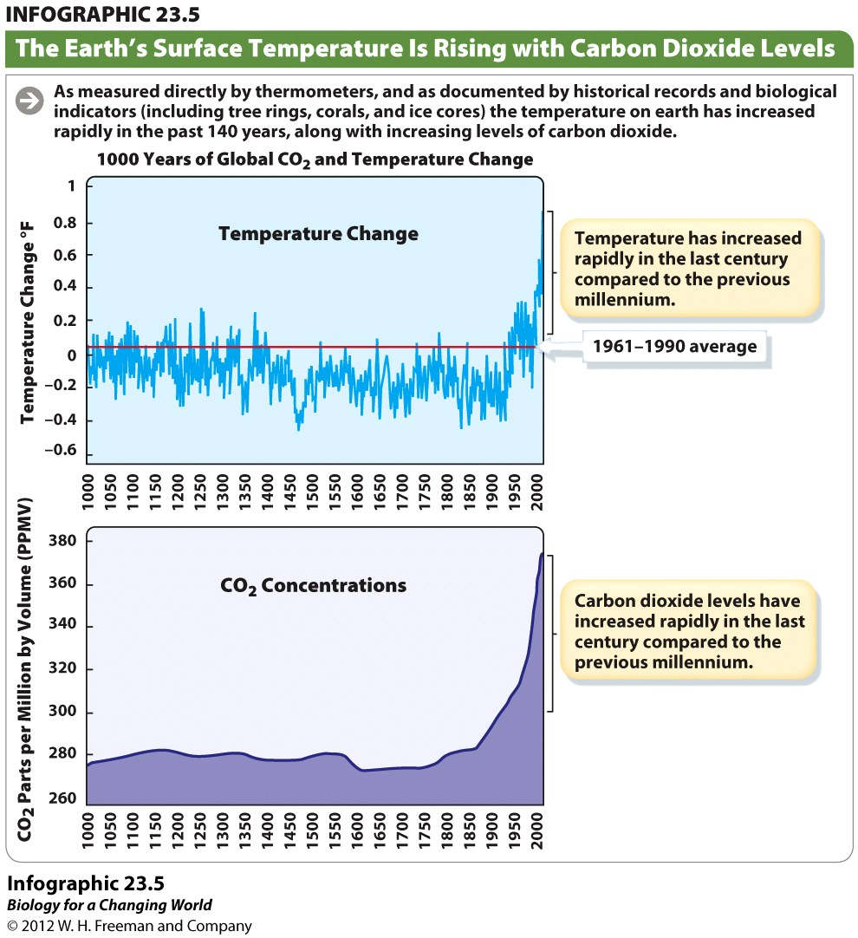

Slide 21
Global Warming
Since the Industrial Revolution, the concentration of CO₂ in the atmosphere has been increasing due to the burning of fossil fuels and wood and to deforestation.
Increased CO₂ leads to a Greenhouse effect which increases the temperature near the earth’s surface.
Copyright © 2007 Pearson Education Inc., publishing as Pearson Benjamin Cummings

Slide 22
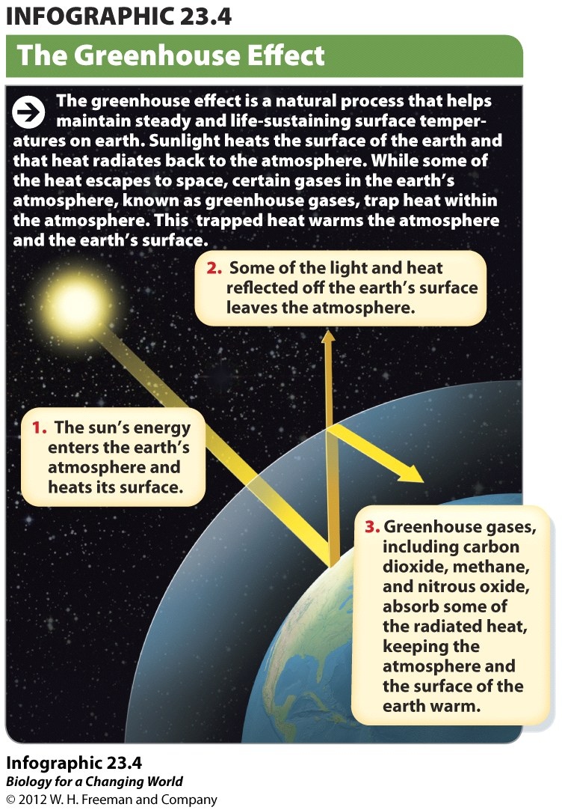
The Greenhouse Effect
As sunlight shines on earth, it warms the earth’s surface. This heat radiates back to the atmosphere, where it is absorbed by greenhouse gases, keeping the atmosphere and surface of the earth warm.

Slide 23
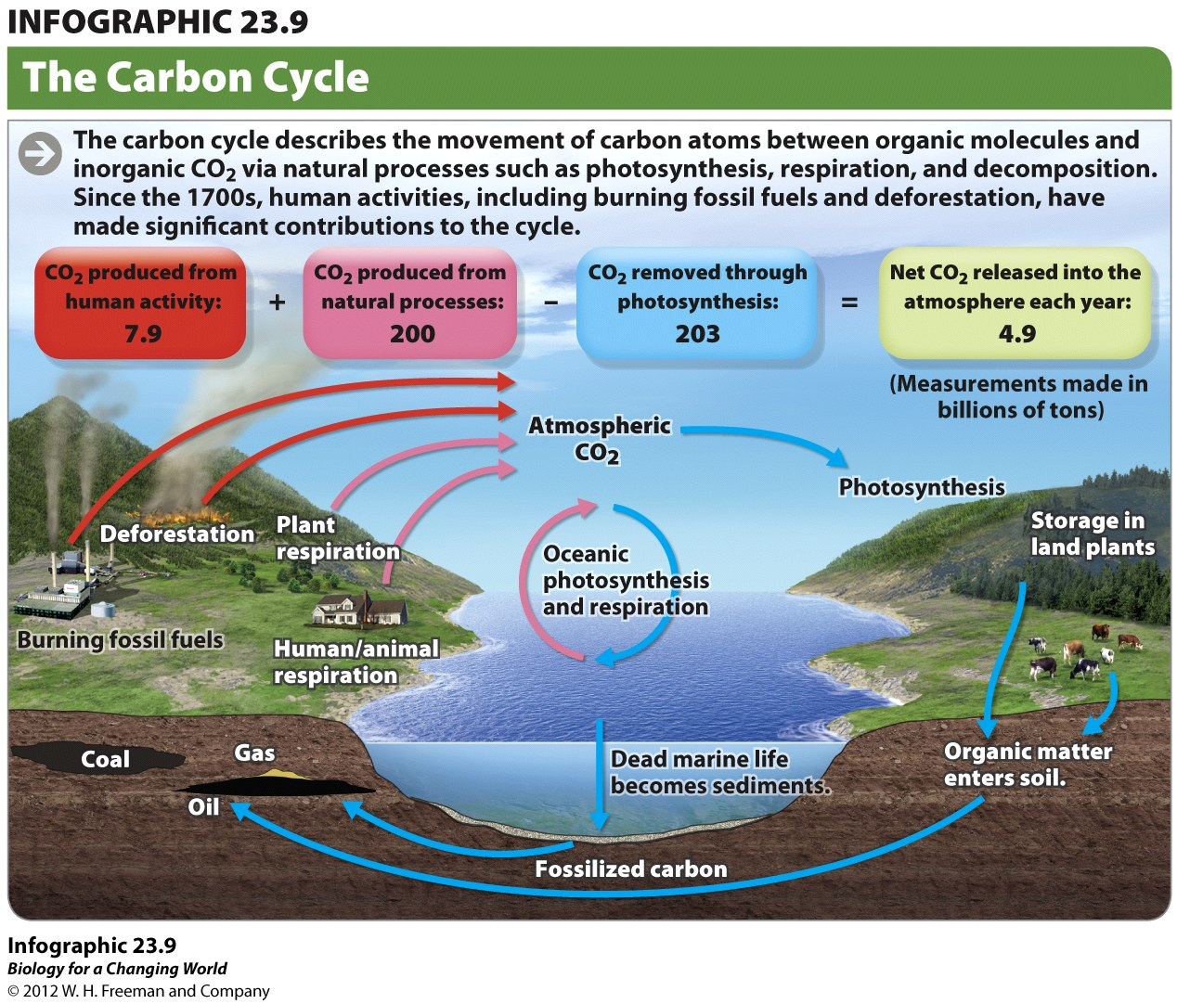
The Carbon Cycle
Notes:
Study this slide, ask a peer, what is going on and what is important?
Why not equal
Where does coal, natural gas and oil come from?
Release essentially inert Carbon and put it in air – takes millenia to remove it via these processes

Slide 24
The Earth’s Surface Temperature is Rising
As measured directly by thermometers, and through historical records and biological indicators (including tree rings, corals, and ice cores) the temperature on Earth has increased rapidly in the past 140 years.
Temperature increased an average of 1 degree F in the last 100 years
Temperature has increased rapidly in the last century compared to those during the rest of the millenium.
Variations of the Earth’s surface temperature over the last 140 years and the last millenium. [From the Intergovernmental Panel on Climate Change (IPCC) report, Climate Change 2001: The Scientific Basis.]
Notes:
www.noaanews.noaa.gov/stories2005/s2442.htm
(see Mann, Bradley, and Hughes, 1998 and Mann, Bradley, and Hughes, 1999),

Slide 25
Ecosystem Services
Benefits to humans that are provided by natural systems
Can be assigned monetary value (to emphasize benefits)

Slide 26
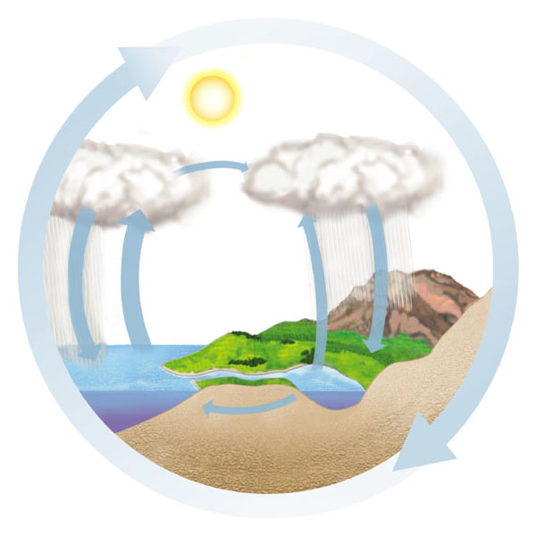
The Water Cycle
0
Water moves through the biosphere in a global cycle
Solar heat
Drives the global water cycle of precipitation, evaporation, and transpiration
Transport over land
Solar energy
Net movement of water vapor by wind
Precipitation
over ocean
Evaporation from ocean
Precipitation over land
Evaporation and
transpiration from
land
Percolation
through soil
Runoff and
groundwater

Slide 27
Ecosystem Services: Do Forests Protect Environment for Humans?
The Hubbard Brook Experimental Forest is a study site for chemical cycling in a forest watershed.
Copyright © 2007 Pearson Education Inc., publishing as Pearson Benjamin Cummings

Slide 28
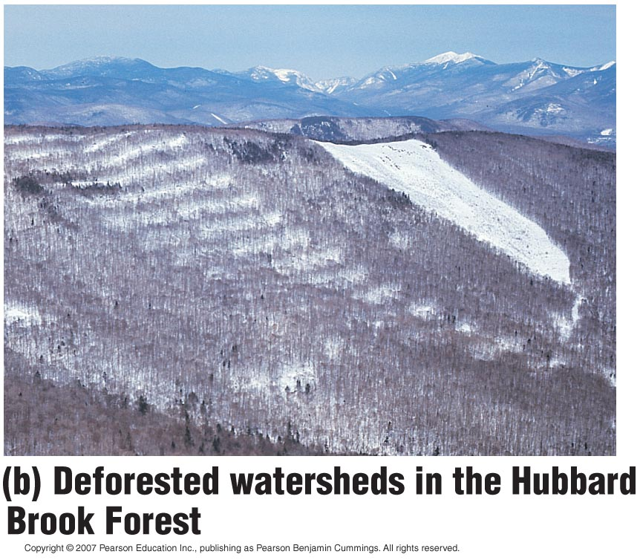
One valley was completely deforested,
And the inflow and outflow of water and minerals was compared to a control area.

Slide 29
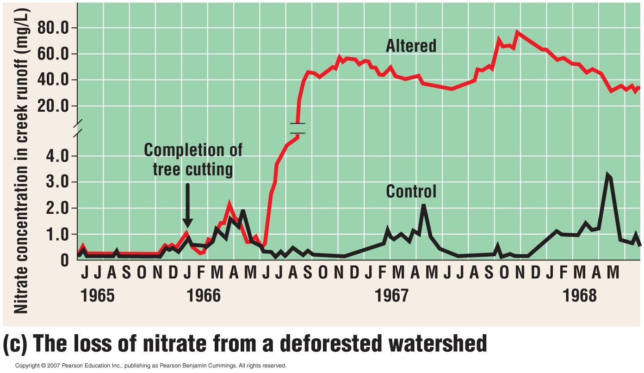
Notes:
Nitrate is important for plant growth
Net losses of minerals from the altered area were huge (note break in graph),
exhibiting the impact of human activity on a forest ecosystem therefore the trees are offering a monetary benefit = ecosystem services

Slide 30
Fragmentation is the term that describes allowing areas of large forests to be cut down in ways that leaves small parts intact.
Corridors are intact ecosystems left between fragments to allow movement of animals between them.

Slide 31
Effects of deforestation:
Food web topples
Promotes soil erosion
reduces soil fertility
contributes to water pollution
Enhances the greenhouse effect
burning releases CO₂
fewer trees means less CO₂ being used up

Slide 32
A watershed is the land area that collects precipitation and funnels it into rivers or other water bodies.

Slide 33
Loss of Biodiversity
Biodiversity is believed to be a critical factor in maintaining the stability of natural systems.
Notes:
Under stress, an ecosystem with more diversity provides stability

Slide 34
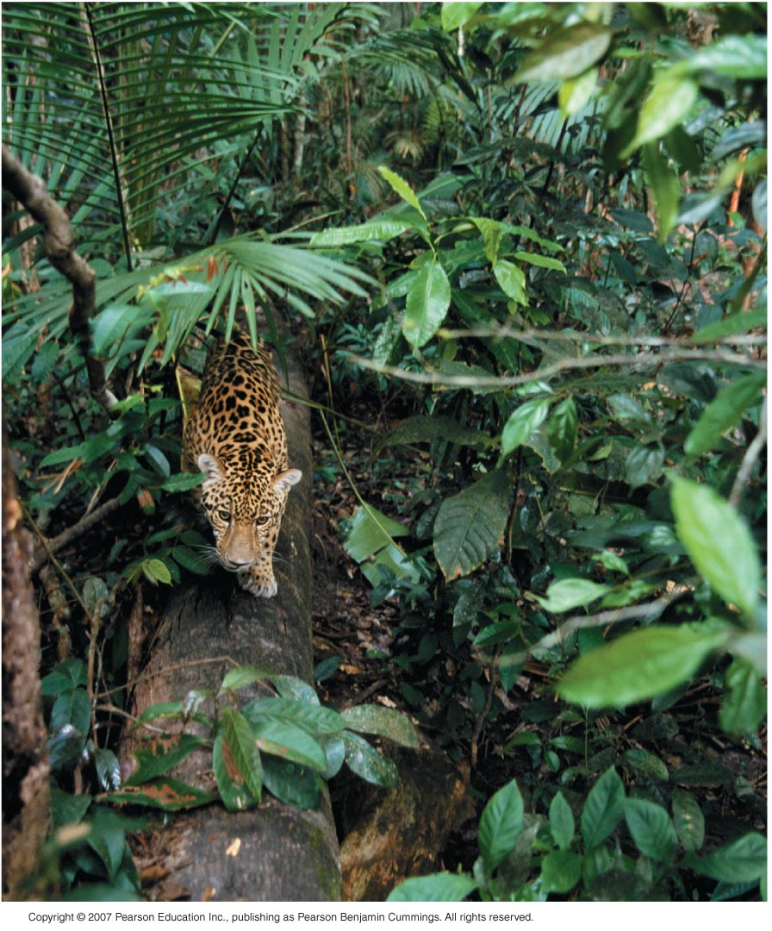
The Three Levels of Biodiversity
the diversity of ecosystems.
the variety of species that make up the biological community of any ecosystem.
the genetic variation within each species.

Slide 35
The Biodiversity Crisis
The effect of human activity on ecosystems is an alarming biodiversity crisis
Several researchers estimate that at the current rate of destruction, over half of all plant and animal species will be gone by the end of the 21st century.
Notes:
Mass extinction event
”

Slide 36
The Loss of Species
The current mass extinction
Is being caused by human activity.
Is broader and faster than other past extinctions.

Slide 37
12% of the known bird species in the world and 24% of the known mammal species are threatened with extinction.
Of the 20,000 known plant species in the United States, 200 have become extinct and 730 are endangered or threatened.
About 20% of the known freshwater fishes in the world have become extinct or are seriously threatened.

Slide 38
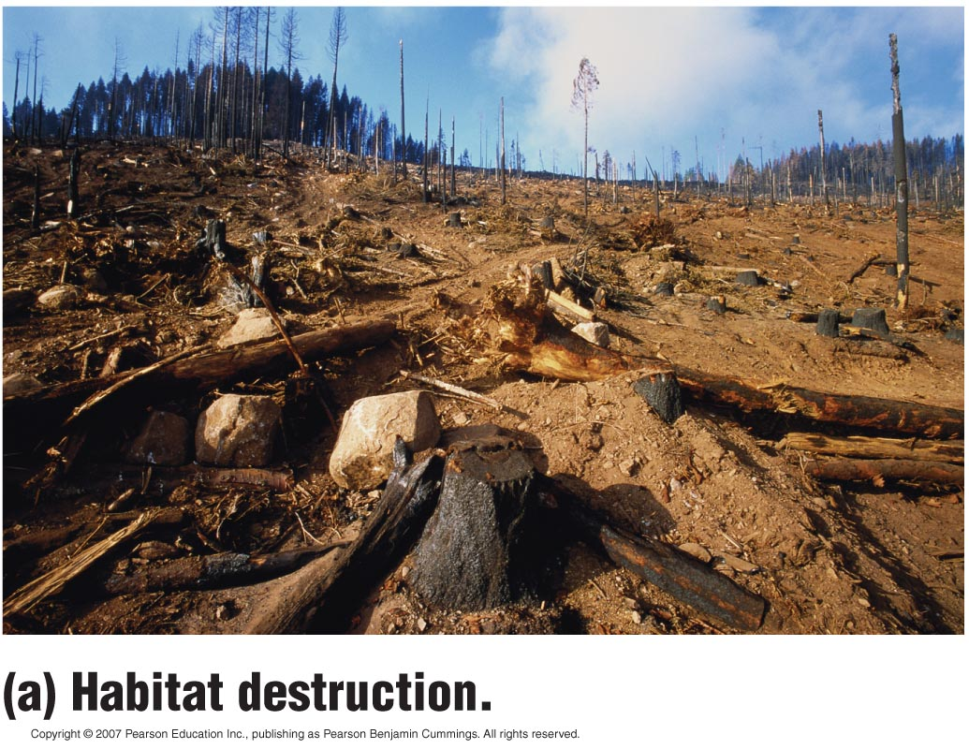
Main Cause of the Biodiversity Crisis
Human alteration of habitat
Poses the single greatest threat to biodiversity throughout the biosphere.
Copyright © 2007 Pearson Education Inc., publishing as Pearson Benjamin Cummings
Notes:
Humans are directly involved in altering many habitats (convert natural areas into farms, subdivisions, industrial centers, marinas).

Slide 39
An endemic species is a species that is native to a habitat and is not found elsewhere.
Preserving endemic species is a high conservation priority.

Slide 40
Conservation management
Co-management is one form of collective action whereby resource stakeholders work together with a government agency to undertake some aspect of resource management.

Slide 41
Vocabulary for research studies
Transect is a systematic sampling ecology technique in which samples are taken at fixed intervals, usually along a line.
Riparian is the area on the banks of a stream
Hectare is a unit of measurement (1 hectare = 2.47 acres)
Spearman’s rank correlation – measures the degree to which two things are correlated with 0 being no correlation and 1 being maximal correlation
Liana is a woody vine

Slide 42
Questions?
ASK!!

