Slide 1
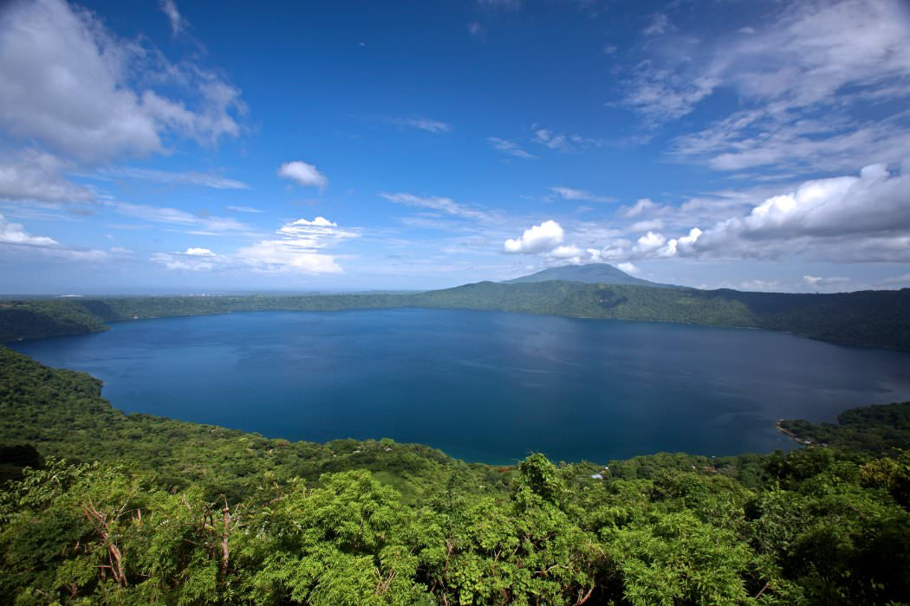
Nicaragua
A brief overview of history, culture, and climate

Slide 2
Geographical Information

Slide 3
Geographical Information cont.
The land of lakes and volcanoes: over 40 volcanoes
Largest but most sparsely populated country in Central America
Pacific and Caribbean coasts are culturally and economically very different
Two big lakes: Lake Managua and Lake Nicaragua

Slide 4
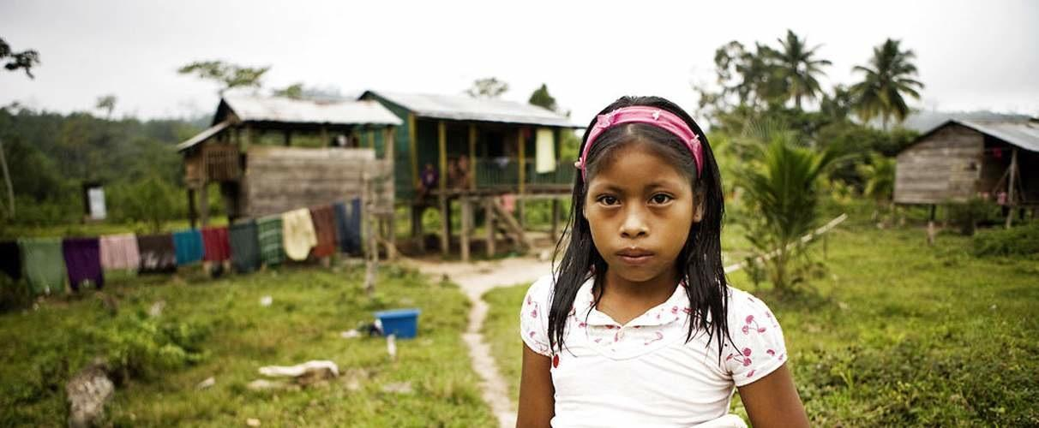
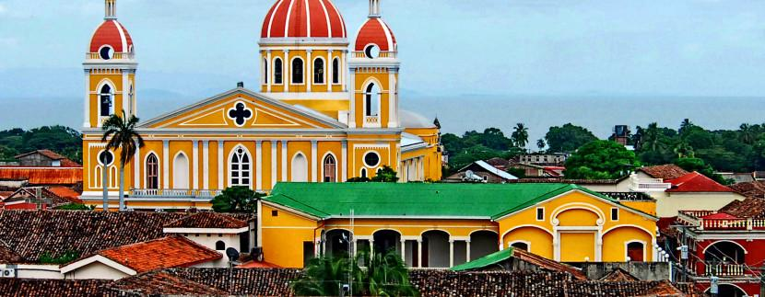
Basic Information
Population: 6.3 million
Current capital: Managua
Other main cities: Leon, Granada, Masaya, Chinandega
Elected President and Vice President: Daniel Ortega and Rosario Murillo
Nicaragua is the safest and most secure country in Central America

Slide 5
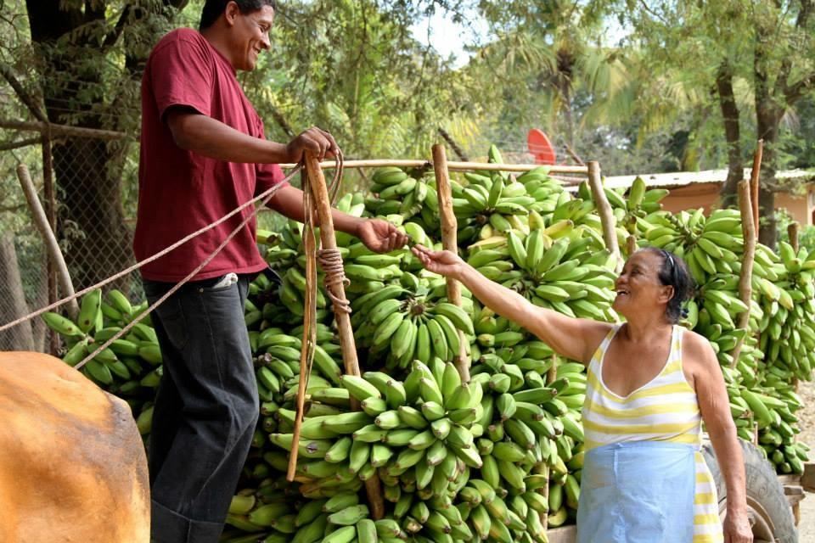
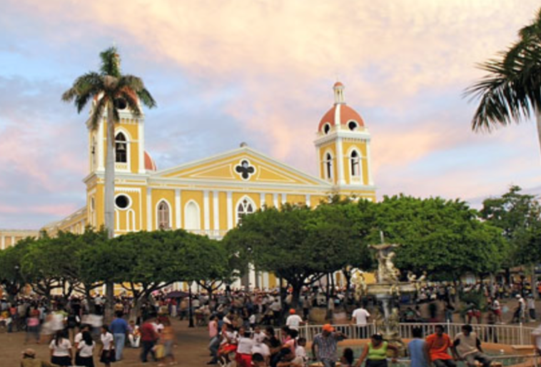
Economy
Second poorest country in the Western Hemisphere
42.5% of Nicaraguans live on less than $1 per day and 75.8% of the population lives on less than $2 per day
Underemployment is at 46.5%
Exports: coffee, bananas, sugarcane, cotton, rice, corn, tobacco, sesame, soya, beans, beef and shrimp

Slide 6
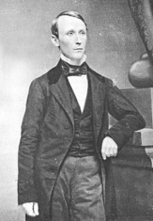
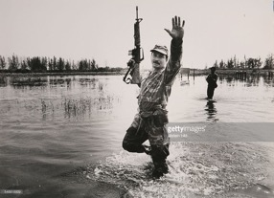
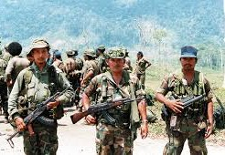
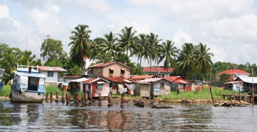
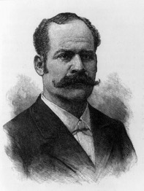
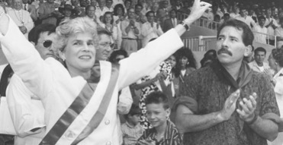
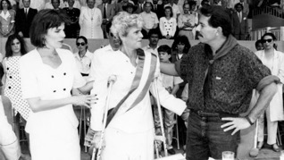
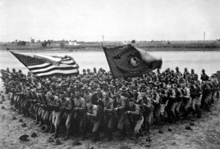
History of the US in Nicaragua
1855-57: William Walker, “The King of Filibusters”, usurps power and declares himself President of Nicaragua
1860s: India rubber boom leads to increased US trading settlements in Bluefields, Pearl Lagoon, and other coastal villages
1894: US controls 90% of production and has capital investments in coconuts, bananas, rubber, gold mining, transportation, and commercial enterprise. Bluefields becomes an economic hub and undergoes a population boom
1912: President Zelaya attempts to find another country to build a canal in Nicaragua. US views this as a violation of the Monroe Doctrine and the Roosevelt Corollary and outs Zelaya. US imperial rule begins
1927: Henry Stinson forces a peace treaty on Nicaragua and secures the US's military's right to run Nicaraguan elections. To ensure democracy, the US assembles a Nicaraguan military force, La Guardia
1979-1990: Contra War. Approximately 30,000 Nicaraguans killed, thousands more wounded, 350,000 internally displaced, and $9 billion in direct damages
1990: The National Endowment for Democracy spends $11 million on the election in Nicaragua. Grants made out to UNO were supposedly for vehicles or office equipment, but UNO used the money to support their candidate. This was later referred to as the "blueprint" for successful US intervention in third world countries

Slide 7
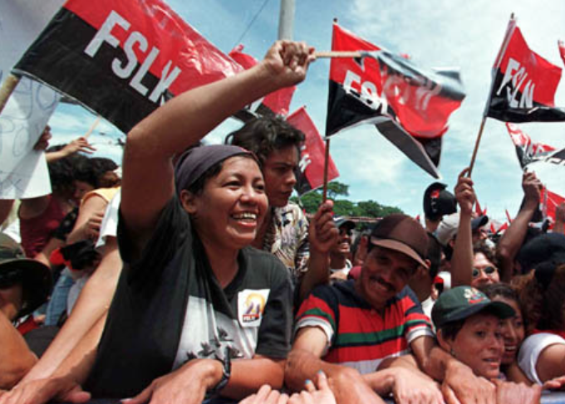
Politics
Somoza dictatorship (1936-1979)
“Somoza may be a son of a bitch, but he’s our son of a bitch.” – Franklin D. Roosevelt
Sandinista (FSLN) revolution ousts Somoza on July 19, 1979
Counterrevolution leads to conflict during the 1980s; the counterrevolution is supported by the US; Daniel Ortega is elected President in 1984
Free elections in 1990: Ortega loses to Violeta Chamorro; first time in over five decades there is a peaceful and democratic transfer of power

Slide 8
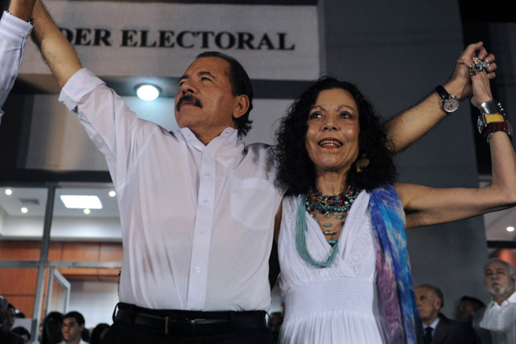
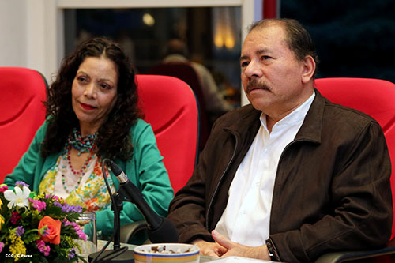
Politics, cont.
Ortega is reelected in 2006, 2011, and 2016
Many Nicaraguans believe that the political system is corrupt and that Ortega is a dictator
Election of 2016: Ortega faced no political opposition; his wife is the elected vice president

Slide 9
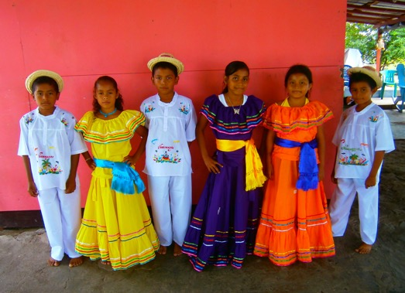
Dress
Traditional garb is worn for celebrations or festivals
Dress modestly
HIGHLY recommend loose/free flowing pants
Not many people wear shorts, you can, but you may feel less comfortable
Chacos/outdoor sandals are a great, comfortable option

Slide 10
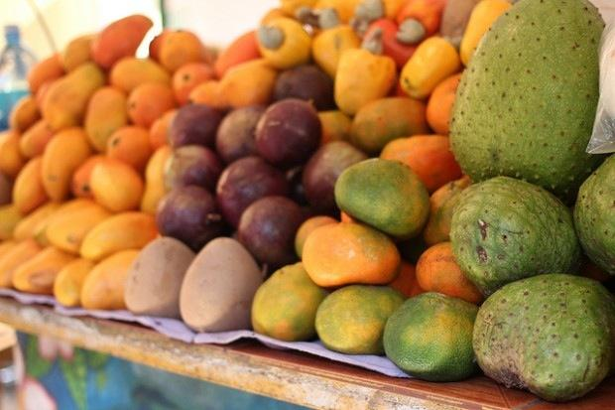
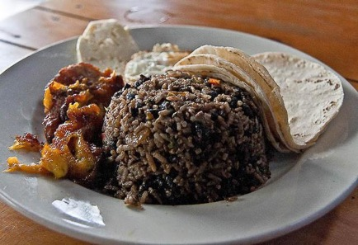
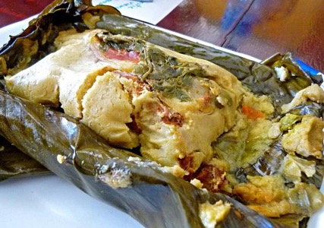
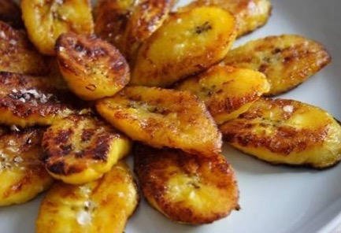
Food
Gallo Pinto, Rice and Bean, Gallo Pinto, more rice, more beans!
Tortillas
Nacatamales
Fresh fruit and juices
Platanos! Sweet or savory fried plantains
Coffee
Lunch is the biggest meal of the day

Slide 11
Courtesy Norms
Customary to greet and bid farewell to everyone in a room
Use your manners (por favor, gracias, buenos días)
Handshakes
Cheek-to-cheek kissing as a greeting
Don and Doña are used as a form of respect for adults

Slide 12
Important Considerations
Men/Boys are taught from a young age to cat call: keep walking
Toilet paper is placed in trash cans next to toilets not flushed
Drink bottled water or bottled sodas, not fruit drinks
Avoid salads and uncooked vegetables as well as unpeeled fruit
Notes:
Many locals have a preferred driver and will give their number, the UCA will also give you taxi numbers

Slide 13
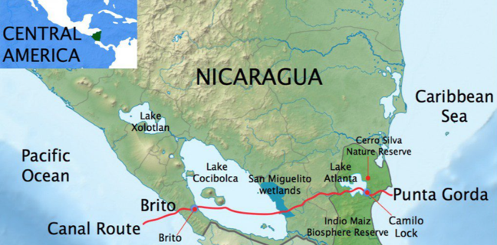
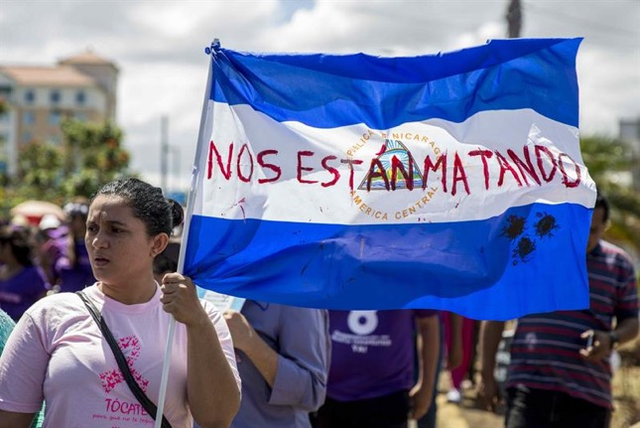
Current Events
Proposed Interoceanic canal
A Chinese corporation plans to build a canal through Nicaragua
Poses a threat to the people and the environment
Water
Ground water is rapidly depleting due to deforestation and pollution
87% of Nicaraguans have access to clean water but statistics are not truly representative because in many urban places water faucets only work a few hours a day
Women
Violence against women has increased in quantity and cruelty
Women are coming together to demand better treatment and more protection from the law

